Slide 1
DIWALI SALES DATASET ANALYSIs

Slide 2
Introduction:
Let's explore a dataset that provides insights into a Diwali sale, capturing valuable details about customer behavior and purchasing patterns. This dataset includes the following attributes:
User ID: A unique identifier for each customer.
Customer Name: The name of the customer, providing personalization for analysis.
Product ID: A unique identifier for each product purchased.
Gender: The gender of the customer, helping analyze purchasing patterns across different demographics.
Age Group: The categorized age range of the customer, offering insights into group-specific preferences.
Age: The specific age of the customer for more granular analysis.
Marital Status: Indicates whether the customer is single, married, etc., revealing behavioral differences in purchasing.
Zone: The geographical zone where the customer resides, providing regional insights into sales performance.
Occupation: The customer’s profession, helping in segmenting customers based on their job roles.
Product Category: The type or category of product purchased, crucial for identifying top-performing product lines.
Amount: The total sales amount associated with each transaction, serving as a key metric for revenue analysis.
This dataset offers a comprehensive view of customer demographics, product preferences, and financial contributions during the Diwali season. By leveraging this data, we can derive actionable insights to optimize sales strategies, target specific customer segments, and improve overall marketing efforts.

Slide 3
Abstract:
The study aims to analyze customer purchasing behavior during Diwali sales using a comprehensive dataset. The analysis focuses on three key objectives:
Sales Performance:
  Identify the top-performing product categories based on sales amount to understand product preferences during the festive season.
  Pinpoint the state generating the highest revenue to highlight regional sales trends.
Customer Insights:
  Investigate purchasing patterns across demographics such as gender, age group, and occupation to uncover valuable customer segments.
  Identify high-value customers by analyzing total spending, enabling targeted marketing strategies.
Sales Trends:
  Evaluate the average order value per transaction to gauge spending behavior.
  Explore the relationship between order count and total amount spent to understand the purchasing frequency and value correlation.
By leveraging visualization tools such as bar charts, maps, doughnut charts, and scatter plots, the analysis provides actionable insights into customer behavior, helping businesses optimize their strategies for future sales events.

Slide 4
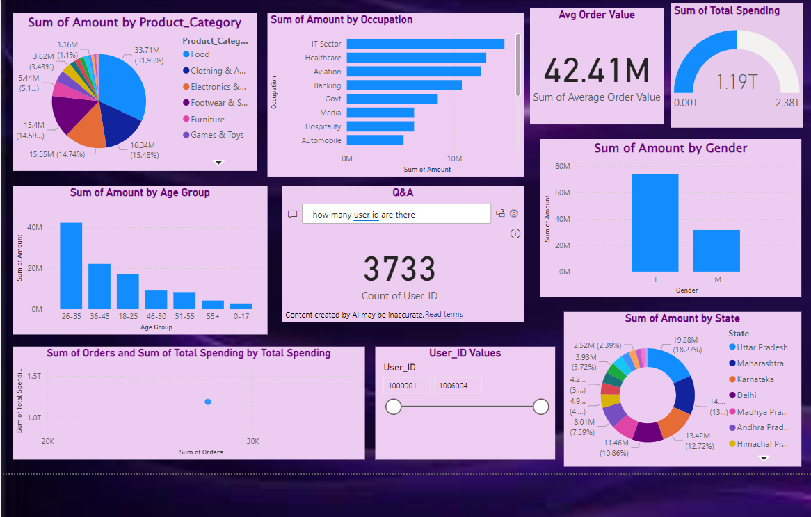

Slide 5
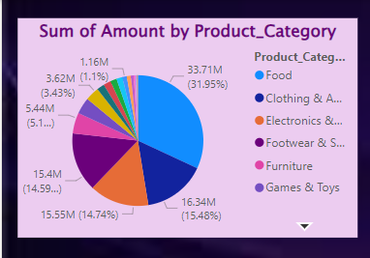
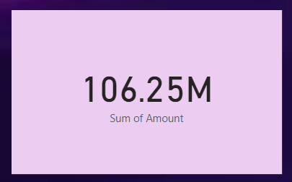
1)Sales Performance:
Identify the top-performing product categories by sales amount.
Determine which state generated the highest revenue.
Top-Performing Product Categories by Sales Amount
Pie Chart:
Pie charts are a suitable choice for analyzing top-performing product categories during Diwali sales, as they visually represent the contribution of each category to total sales. This type of chart focuses on proportions, making it easy to identify dominant categories.
Why Choose Pie Charts?
Clear Proportions: Pie charts highlight the percentage contribution of each category, making it simple to identify the top contributors.
Quick Insights: The visual breakdown helps provide a quick overview of category dominance without delving into numerical details.
User-Friendly Representation: The circular layout is intuitive and simplifies the identification of leading categories, especially for stakeholders unfamiliar with numerical data.
Focus on Comparison: They allow viewers to easily compare category shares relative to others in the overall sales.
For instance, if electronics account for 40% of the total sales, this can be instantly recognized in a pie chart, providing clarity and emphasizing category dominance effectively.

Slide 6
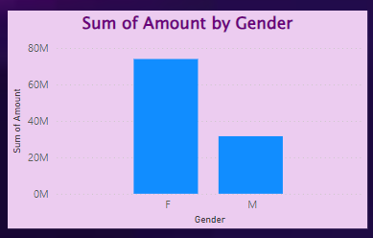
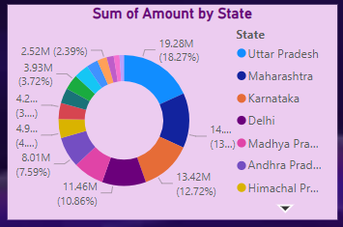
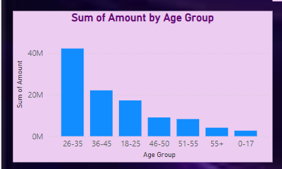
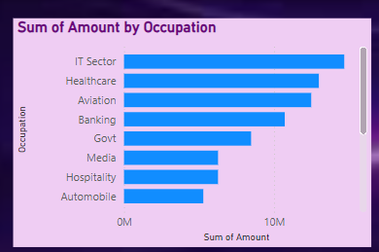
2)Customer Insight: Analyze purchasing patterns based on gender, age group, and occupation, Identify high-value customers (based on total spending).
Gender-Based Purchasing Patterns
Visualization Type: Doughnut Chart
A doughnut chart is ideal for showing proportional sales contributions by gender. It provides:
Quick Comparison: Visualizes the share of total sales by each gender.
Focus on Proportions: Highlights relative contributions clearly.
Space Efficiency: Compact and visually appealing for high-level insights.
Age Group and Occupation Insights
Visualization Type: Clustered Bar Chart / Stacked Column Chart
Clustered Bar Chart: Compares sales across age groups or occupations for each product category.
Stacked Column Chart: Highlights total sales and proportional contributions from each group.
These charts are great for identifying trends and preferences among demographic segments.

Slide 7
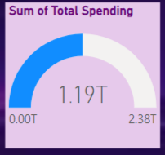
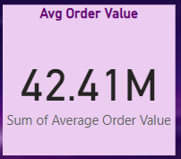
3)Sales Trends: Examine the average order value per transaction, Investigate the relationship between order count and total amount spent.
High-Value Customers – Gauge Chart
A gauge chart is used to represent Total Spending for high-value customers because:
Quick KPI Visualization: Provides an at-a-glance view of customer spending compared to predefined thresholds.
Focus on Metrics: Highlights whether spending is low, moderate, or high with intuitive ranges.
Ease of Interpretation: Suitable for identifying high-value customers in a visually impactful way.
Average Order Value Over Time – Card
A card is chosen to display Average Order Value because:
Focus on Key Metrics: Highlights a single, crucial value in a clean, unobstructed format.
Clarity: Perfect for dashboards where users seek quick insights.
Minimal Design: Eliminates the need for axes, making it suitable for standalone KPIs.

Slide 8
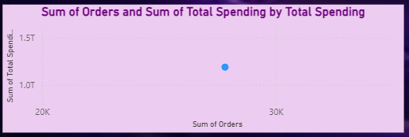
Correlation Between Orders and Spending – Scatter Plot
A scatter plot effectively shows the relationship between order count and total spending because:
Correlation Analysis: Easily identifies patterns, such as whether more orders lead to higher spending.
Distribution Clarity: Displays data points clearly across both axes for precise interpretation.
Outlier Detection: Helps identify unusual behaviors, such as customers with many orders but low spending.

Slide 9
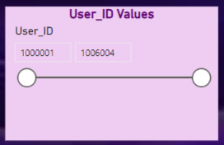
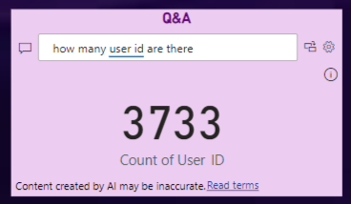
User ID in Slicer:
Including the User ID in a slicer allows users to filter the dataset interactively, focusing on specific customers. This feature is essential for personalized analysis, such as:
Tracking Individual Purchases: Quickly view the spending habits, orders, and preferences of a specific user.
Targeted Insights: Identify high-value customers or unique purchasing patterns.
Streamlined Analysis: Simplifies the dataset, making it easier to evaluate user-specific data.
Q&A Tool:
The Q&A tool enables natural language queries like:
"What is the total spending of User ID 101?"
"How many orders did User ID 202 place?"
It provides quick, user-friendly insights without technical effort.

Slide 10
CONCLUSION:
Analyzing customer purchasing behavior during Diwali sales provides valuable insights into sales performance, customer demographics, and spending trends. Businesses can optimize inventory and regional strategies by identifying top-performing product categories and states with the highest revenue. Understanding gender, age group, and occupation-based purchasing patterns helps tailor marketing campaigns to specific customer segments. Highlighting high-value customers and analyzing sales trends such as average order value and the relationship between order count and spending enables more targeted decision-making. These findings empower businesses to enhance customer experiences, boost sales, and drive data-driven growth strategies.

Slide 11
Thank you !
- RANJANI SHREE R S
- BTECH . IT

